Slide 2
Regeneration and Fuel Loads with Varying Overstory Retention in Redwood Stands 10 Years after Transformation to Multiaged Management
Thesis committee presentation by Judson Fisher

Slide 3
Thank you

Slide 4
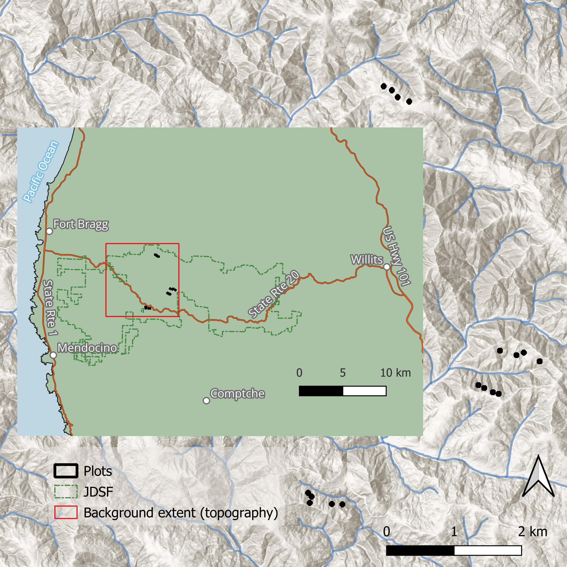

Slide 5
Today’s plan
Why we did it
Why we did it
Some results
My questions
Your questions

Slide 6
Multiaged silviculture is an important part of Ecological forest management
Diversity of forest structures == Diversity of silvicultural techniques
Predominace of even-aged management
This work contributes to our understanding of mulitaged stand development
Greater understanding -> increased adoption

Slide 7
Suitability of redwood forests
Timber value
Shade tollerance
Reliable regneration

Slide 8
Towards fire-informed management in the redwood region
Slow adoption of fire-informed management on the North Coast
Redwood is a fire-adapted species
Historical record shows frequent fire
What is the pyrosilvicultural significance of our management actions?

Slide 9
Today’s plan
Why we did it
What we did
Some results
My questions
Your questions

Slide 10
What we did
Implement experiment
Establish plots and transects
Sample fuels, sprout heights, and sprout densities
Model sprout heights, report densities, model fuels

Slide 11
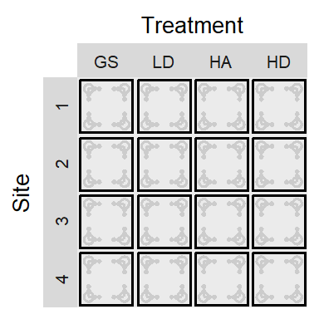
In 2012 we harvested 16 one-hectare blocks using different harvest treatments
GS: Group selection
LD: Low density dispersed
HA: High density aggregated
HD: High density dispersed
These four treatments were replicated across four sites.

Slide 12
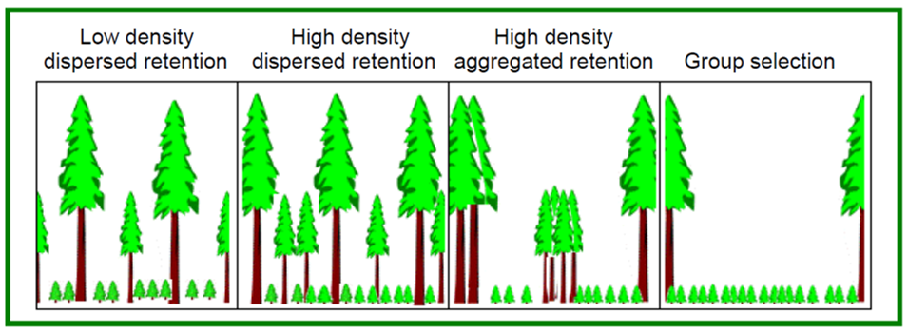
The treatments are defined in terms of retained trees after harvest

Slide 13
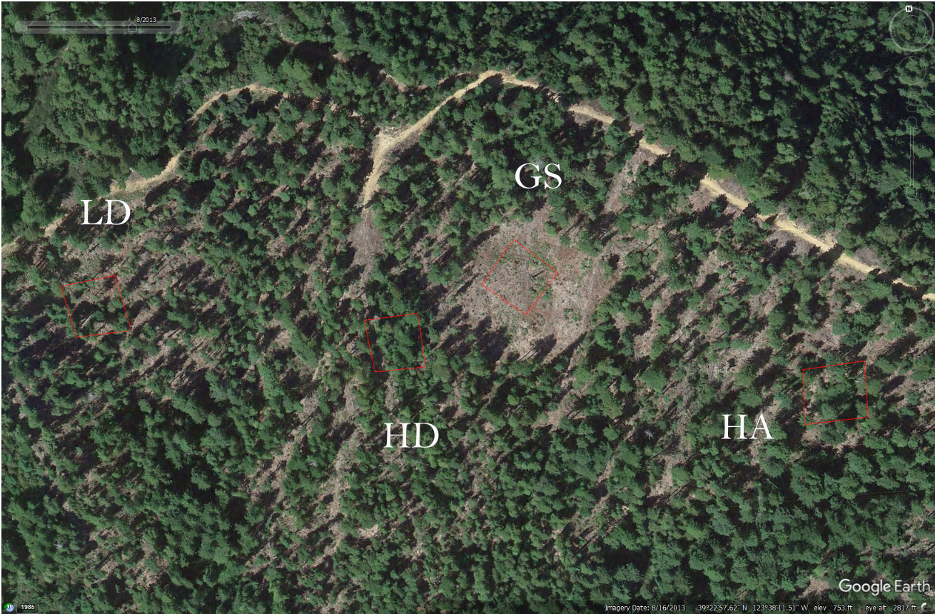
One site

Slide 14
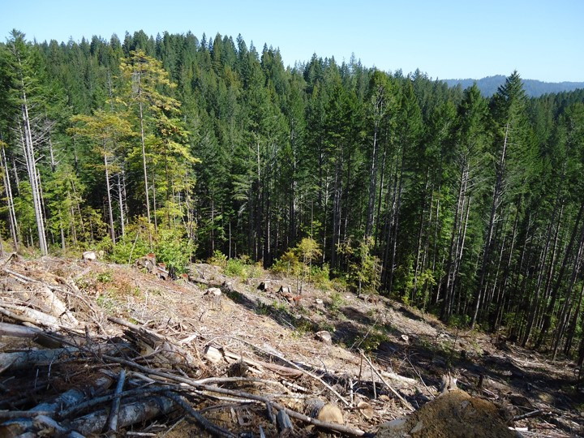
GS

Slide 15
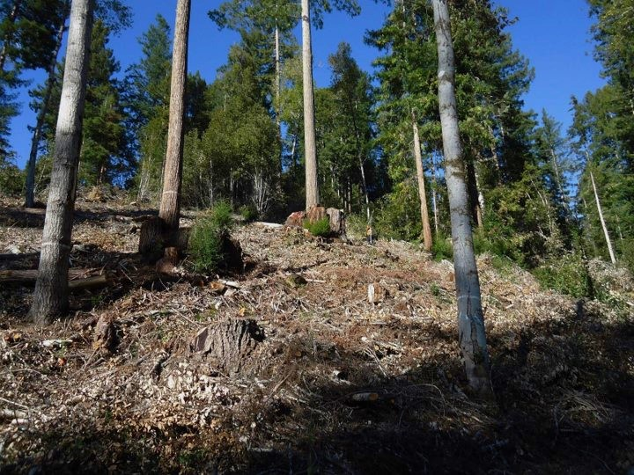
LD

Slide 16
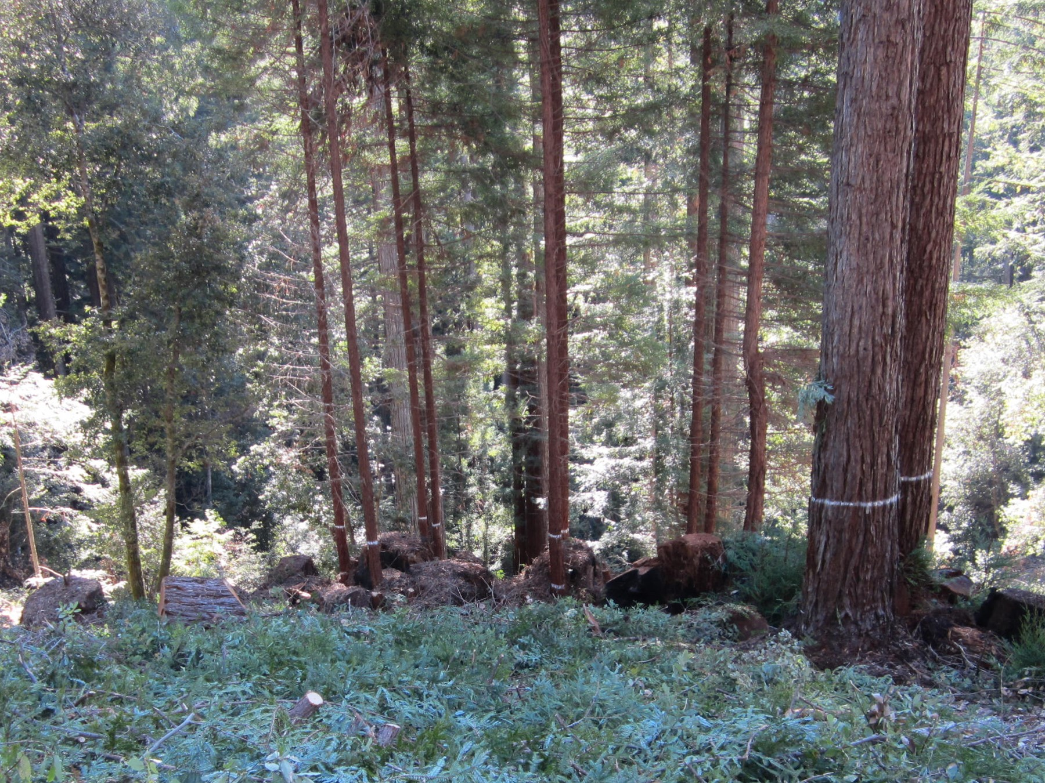
HA

Slide 17
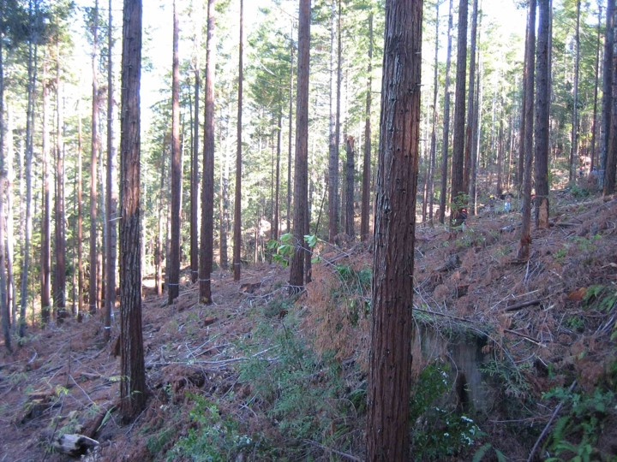
HD

Slide 18
What we did
Implement experiment
Establish plots and transects
Sample fuels, sprout heights, and sprout densities
Model sprout heights, report densities, model fuels

Slide 19
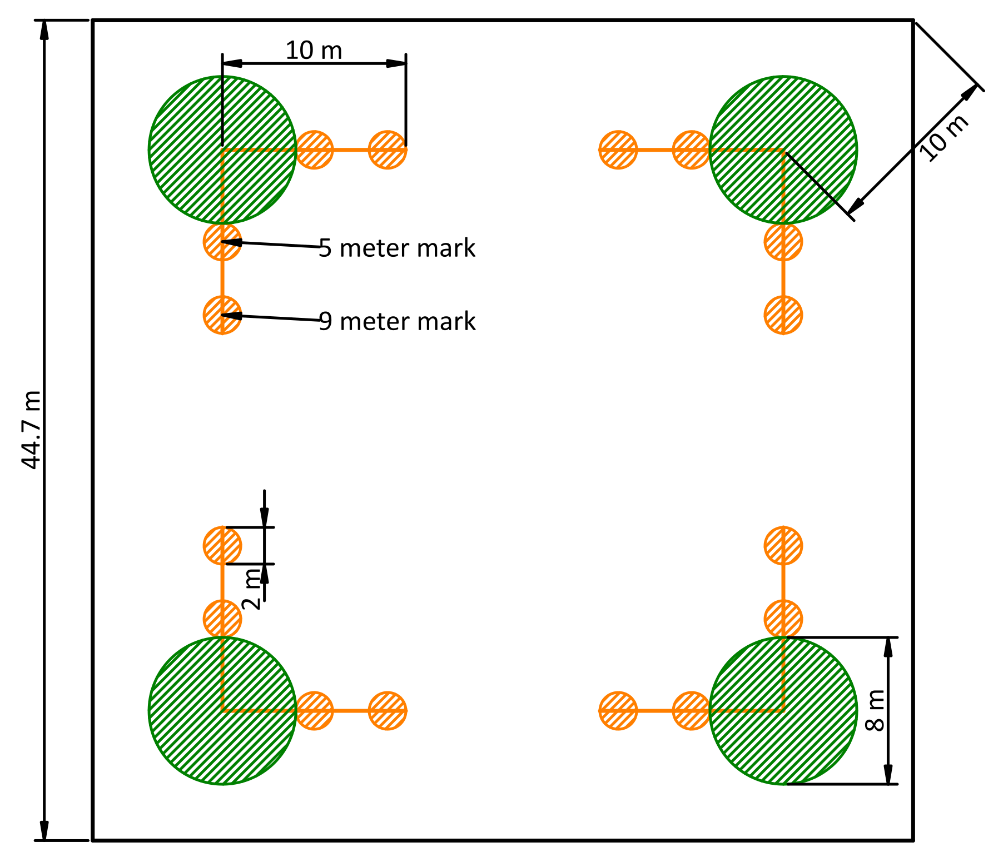
The plot structure
Macro plot (Outline)
Regeneration plots (green circles)
Fuel transects (orange lines)
Fuel sampling cylinders (orange circles)
Notes:
We located macro plots within the center of each treatment block
0.4 ha square macro plot
Four 4-meter radius sprout density plots, near macro plot corners
Two 10-meter transects, terminating at the center of each sprout density plot (eight per macro plot)
Two 1-meter radius sampling cylinders along each transect (16 per macro plot)

Slide 20
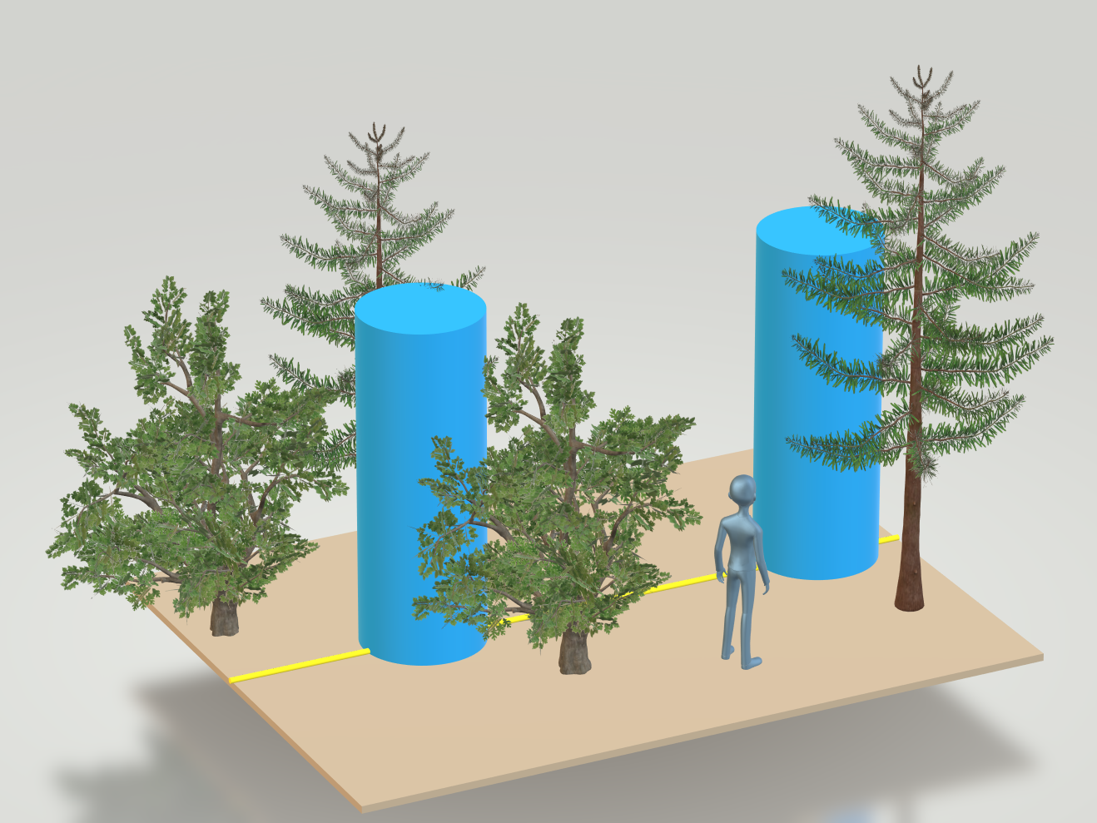
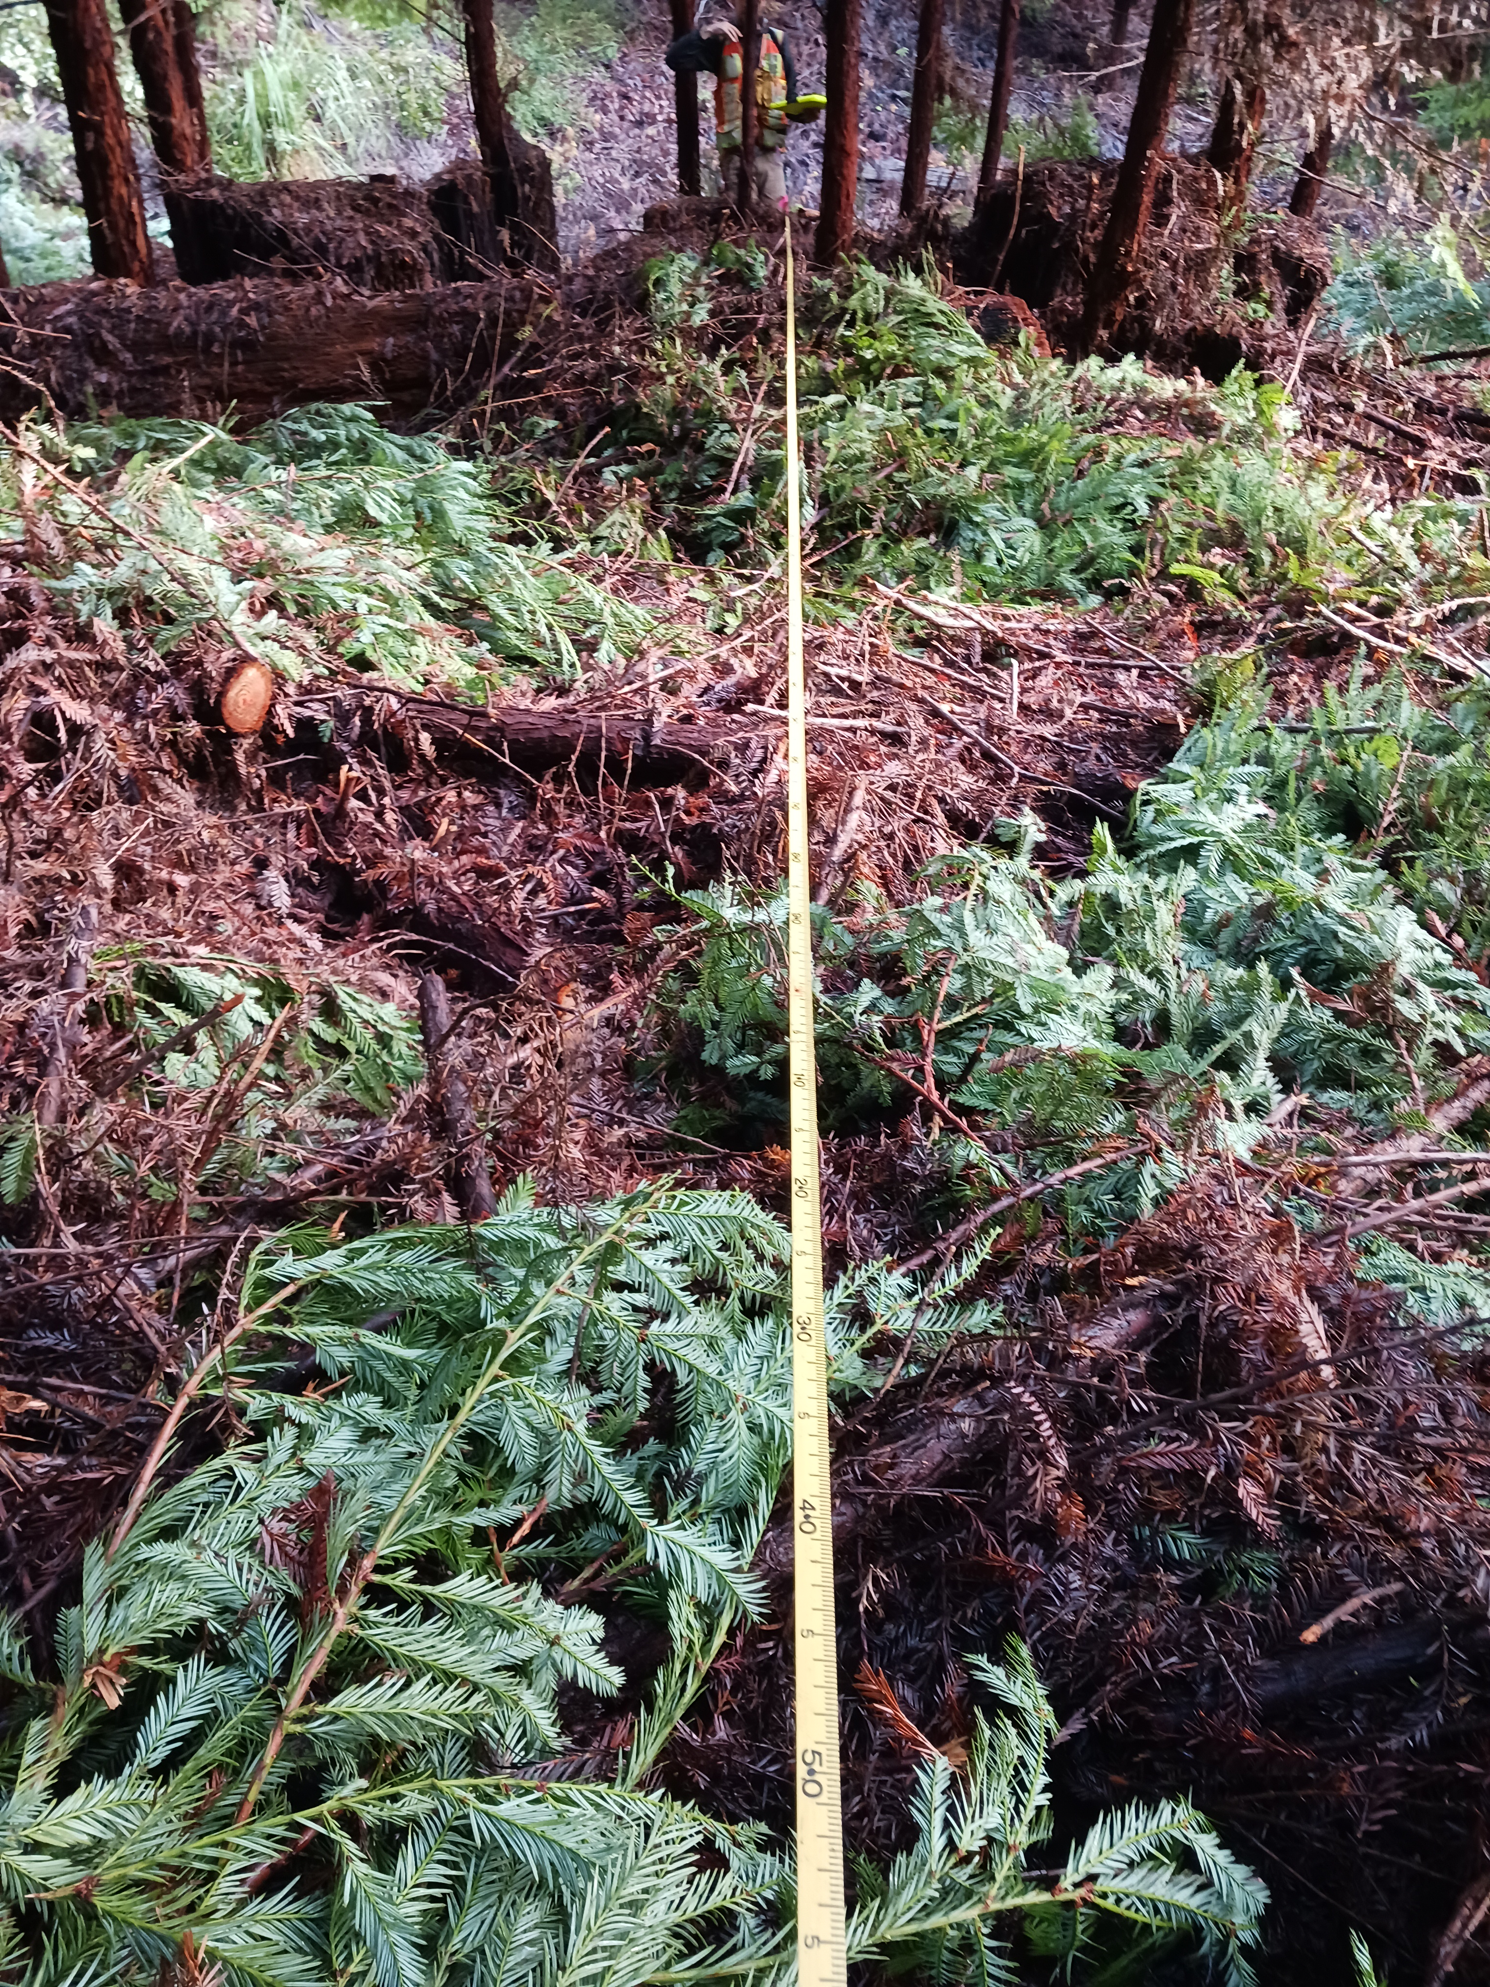
Sampling cylinders
A fuel transect

Slide 21
What we did
Implement experiment
Establish plots and transects
Sample sprout heights, regen. densities, and fuels
Model sprout heights, report densities, model fuels

Slide 22
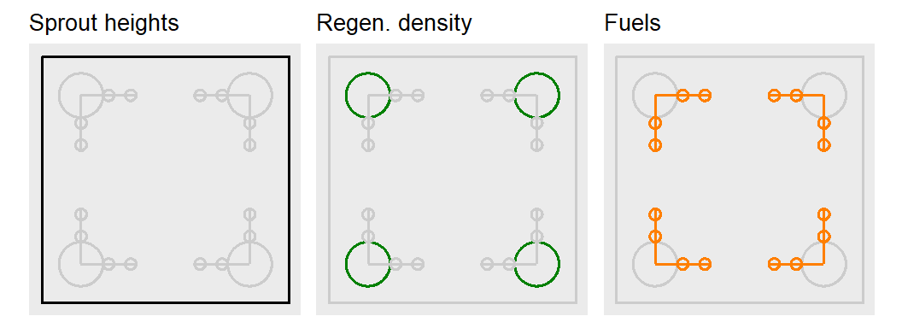
Sampling

Slide 23
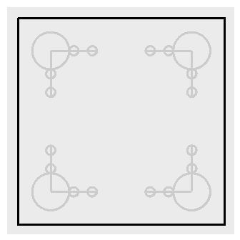
Sprout height
25 each of tanoak and redwood sprout clumps were selected for measurement
Tallest sprout in clump measured at years 1, 5, and 10
Macro plot

Slide 24
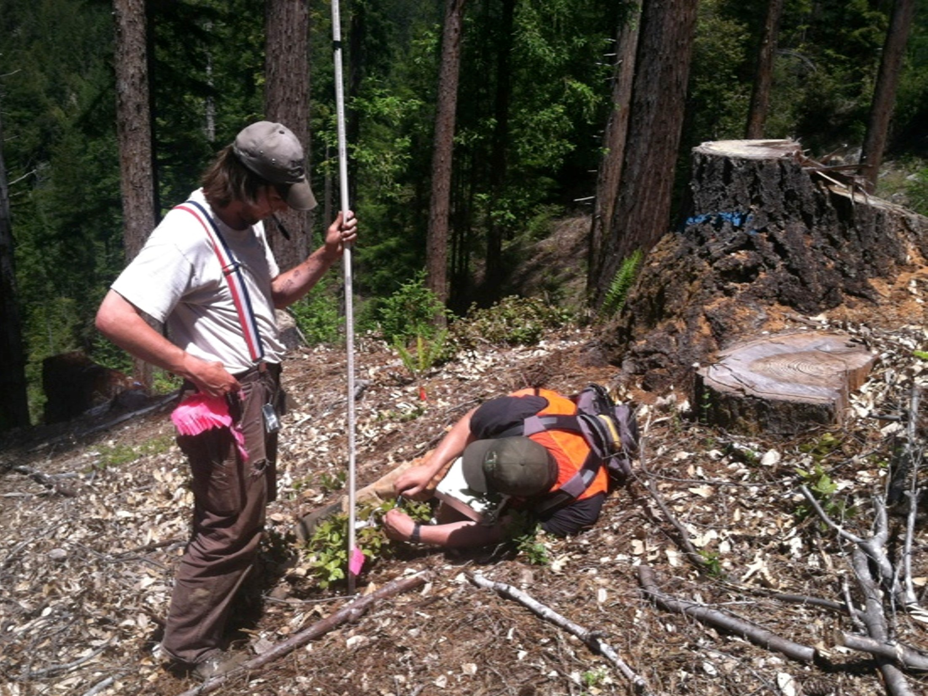
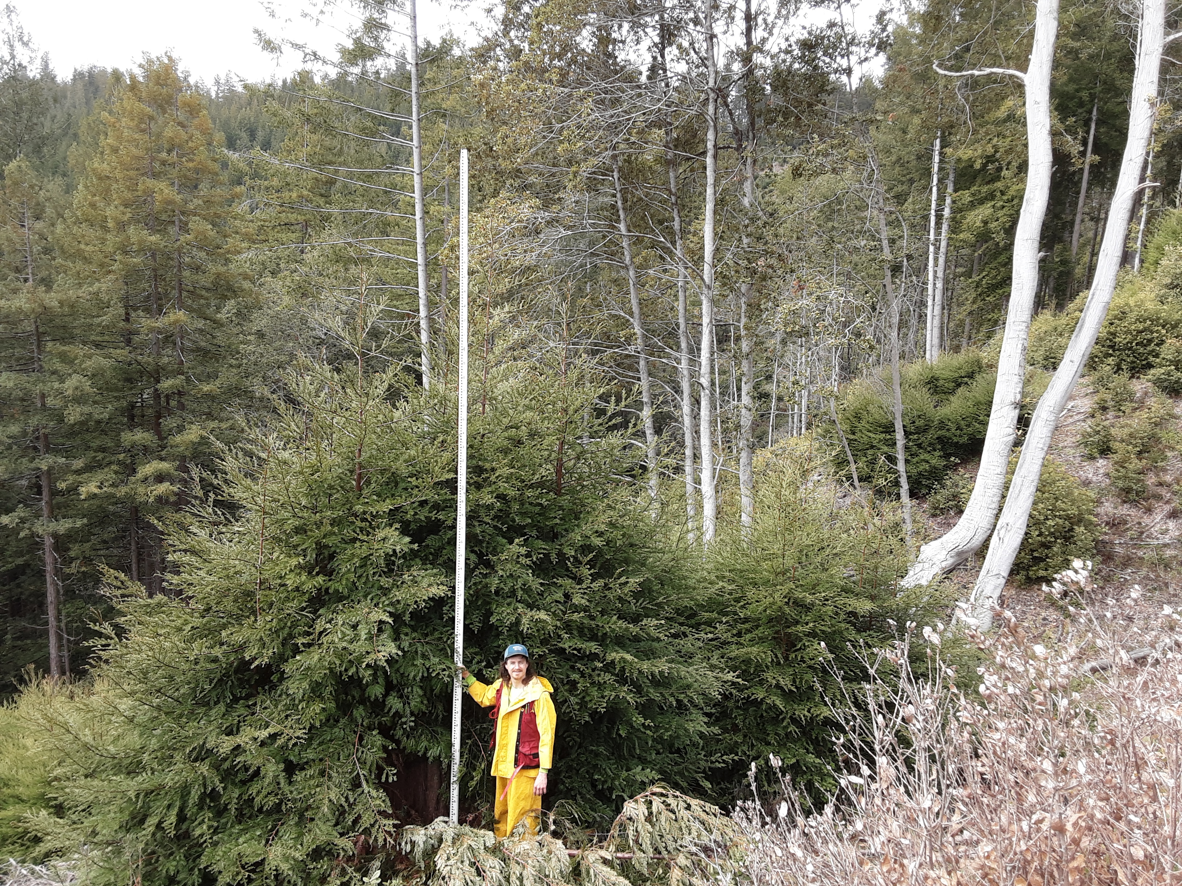
Year 1
Year 10

Slide 25
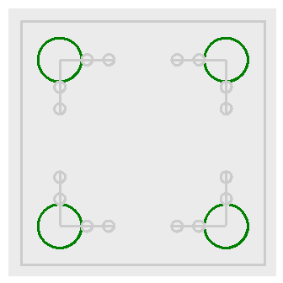
Regeneration density and composition
We recorded diameter and species of all sprouts and seedlings taller than 1.4 m
Regen. plots

Slide 26
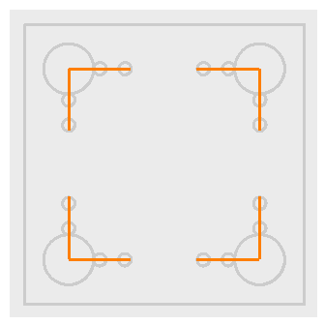
Downed woody fuel
Particles were tallied by size class
Counts were converted to load (Mg/ha) using linear intersect theory and parameters from the literature
Fuels transects

Slide 27
Downed woody fuel classes
Class name | Size (cm) | Transect length (m)
1 hr | < 0.64 | 1
10 hr | 0.64 - 2.5 | 2
100 hr | 2.5 - 7.6 | 4
1,000 hr | > 7.6 | 10

Slide 28
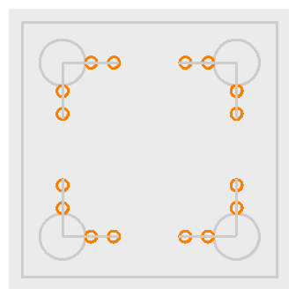
Litter and duff
Litter and duff depth measured from a representative location within the sampling cylinder
Depth-to-load equation taken from the literature
Sampling cylinders

Slide 29
Wet and dry live vegetation
We estimated percent cover and average height for standing vegetation in four classes:
Green (wet) herbaceous
Dry (brown) herbaceous
Green (wet) woody
Dry (brown) woody
Sampling cylinders

Slide 30
Wet and dry live vegetation
We calculated average load for herbaceous and woody vegetation:
$$load=ht.×pct.cover×ρ,$$
where $ρ$ is a bulk density of 8 and 18 Mg/ha/m for herbaceous and shrub components, respectively.

Slide 31
Fuel bed depth
We estimated the combined average fuel bed depth of all litter and downed woody debris within the sampling cylinder.
Sampling cylinders

Slide 32
What we did
Implement experiment
Establish plots and transects
Sample sprout heights, regen. density, and fuels
Model sprout heights, report on regen., model fuels

Slide 33
Sprout height
Frequentist framework
Model selection was performed using AIC
Treatment and year were factors
Tested various random effects
Included fixed effect model for dispersion
Model checked using simulated residuals

Slide 34
Regeneration density
I report on:
Species diameter frequency distributions and
Basal area weighted frequency distributions
for each treatment.

Slide 35
Fuel
Bayesian framework
Separate models for six different fuel classes
Used $gamma$ hurdle model: zeros modeled separately as a proportion
Priors determined from data with support from literature
Model checked with posterior predictive distribution

Slide 36
Today’s plan
What we did
Why we did it
Some results
My questions
Your questions

Slide 37
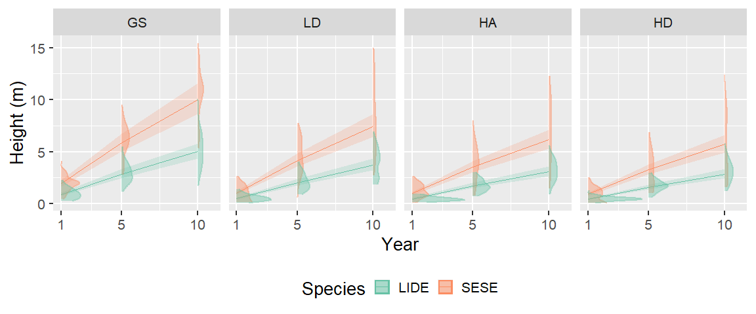
Sprout height model
Notes:
redwood is growing faster than tanoak
redwood is taller than tanoak
slow down in growth rates is negligible across treatments
redwood is more variable than tanoak

Slide 38
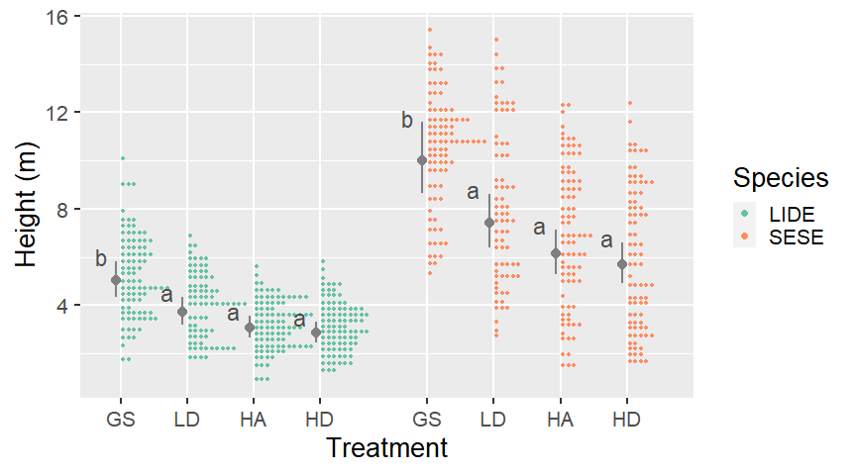
Sprout height: year 10

Slide 39
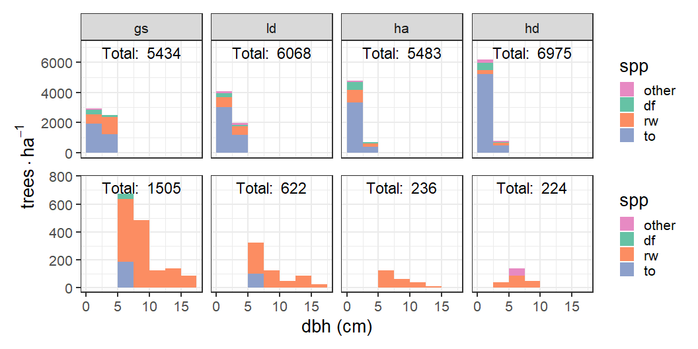
Regeneration density: frequency

Slide 40
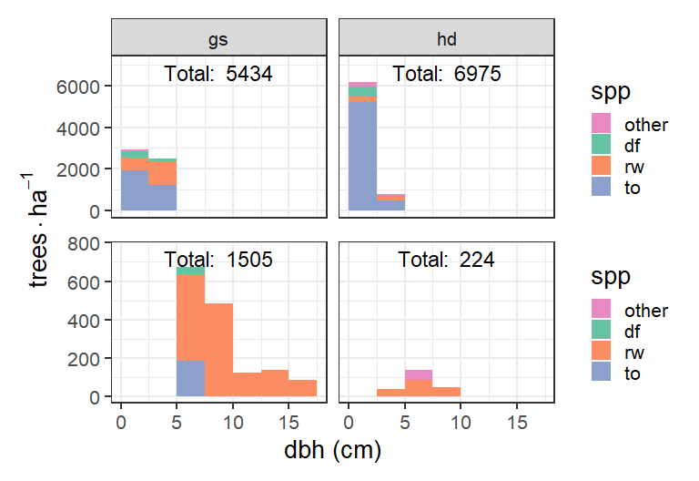
Regeneration density: frequency

Slide 41
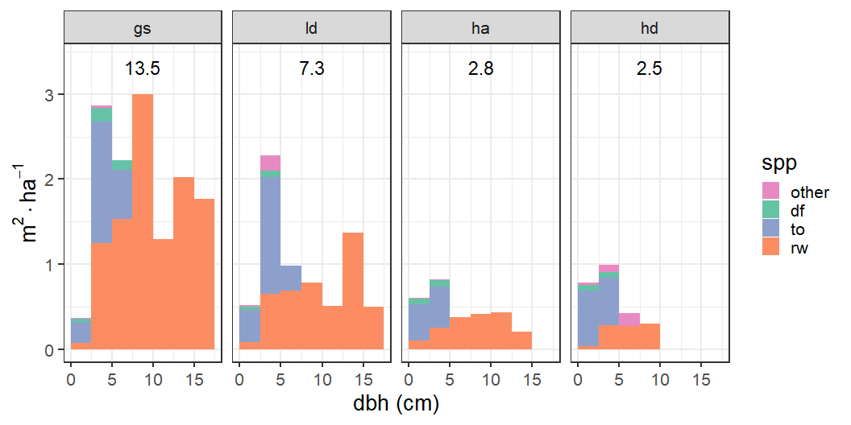
Regeneration density: basal area

Slide 42
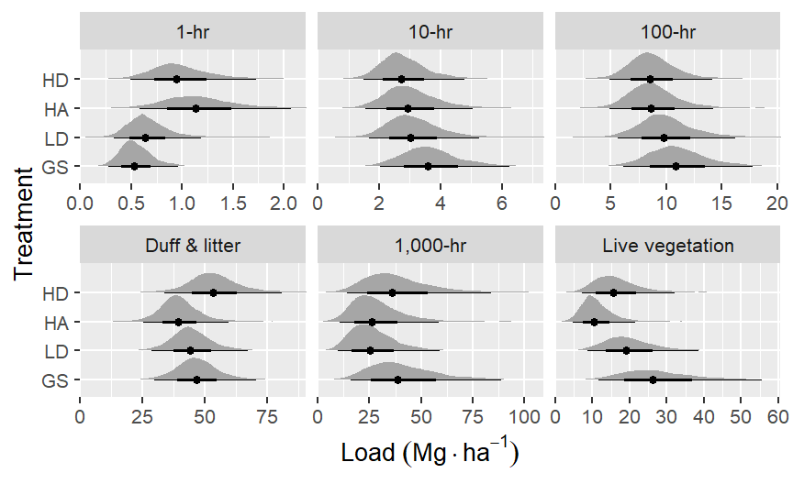
Fuel: means

Slide 43
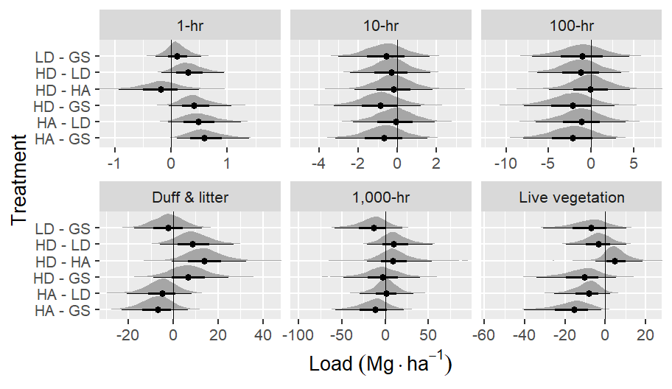
Fuel: comparisons

Slide 44
Today’s plan
What we did
Why we did it
Some results
My questions
Your questions

Slide 45
My questions
How to add post-pct to the story
Potential questions generated by regen. distributions
“Asking questions” of the height model: confidence intervals

Slide 46
Today’s plan
What we did
Why we did it
Some results
My questions
Your questions

Slide 47
Questions?
learn more at online at:
https://fisher-j.github.io/multi-age

Slide 48
Thanks again

